Slide 1

Introduction
Large Integer Arithmetic refers to performing arithmetic operations on integers that are larger than the native word size of the processor. Because it can support only integer calculations of a fixed size, usually 32 or 64 bits,
Typically, these integers are much larger than the maximum 64-bit words supported by most general-purpose processors.
In many applications, large integers used may be 512-bit, 1024-bit, or larger.
Large Integer (or Bignum) Arithmetic must be programmed in software.
For Example:
993,201,713,378,043,612,608,166,064,768,844,377,641,568,960,512,000,000
This number will not fit into a C integer, not even a 64 bit one.

Slide 2
Applications
Cryptography is the major key area:
Public-Key Encryption with RSA Algorithm. E.g. The character string to be encrypted is converted into a sequence of numbers, and encryption keys are stored as long integers.
  Efficient encryption & decryption depends on being able to perform arithmetic on long numbers, typically containing hundreds of digits.
Elliptic Curve Cryptography (ECC)
Other Areas:
High performance computing
Complex research problems
RSA is made of the initial letters of the surnames of Ron Rivest, Adi Shamir, and Leonard Adleman, who first publicly described the algorithm in 1977.

Slide 3

Long Integer Representation
An unsigned arbitrary-size integer can be stored as an array of integers in a positional number system with base B, similar to our ordinary Decimal No. System.
The array {a₀, a₁, …, a_{n-1}} of length n represents the number:
The digits are of course, in the range 0<= a_{i} < B
Addition and subtraction on large numbers is relatively easy. If n is the number of digits, then these algorithms run in O(n) time.
But the standard algorithm for multiplication runs in O(n²) time, which can be quite costly when lots of long multiplications are needed.
Question: Whether there is a more efficient way to multiply two very large numbers?

Slide 4
Normal Int. to a “Big" Int.
Function make_int(A,123)will put 3 in A[0], 2 in A[1], 1 in A[2], and zeros in A[3..N-1]:
// put the normal int n into the big int A
void make_int(int A[], int no)
{
int i = 0;
while (no)
{
A[i++] = no % BASE; // BASE = 10
no /= BASE;
}
while (i < n) // Fill the rest of the array up with zeros
A[i++] = 0;
}
This algorithm takes O(n) time and space.

Slide 5
Adding 1 to a Big Integer
void increment(int A[]) // A++
{
int i = 0;
while (i < n)
{
A[i]++;
if (A[i] == BASE) // BASE = 10
{
A[i] = 0;
i++;
}
else
break;
}
}
This function takes O(n) time in the worst case (imagine 9999999999...) and O(1) in the best case (no overflow in the least significant digit).

Slide 6
Addition of Two Big Integers
To add A[0..n-1] & B[0..n-1] and put the result into C[0..n-1].
void add (int A[], int B[], int C[]) // C = A + B
{
int i, sum = 0, carry = 0;
for (i=0; i<n; i++)
{
sum = A[i] + B[i] + carry;
if (sum >= BASE)
{ carry = 1;
sum = sum - BASE;
}
else
carry = 0;
C[i] = sum;
}
if (carry)
printf ("overflow in addition!\n");
}
This function does constant work in a loop that iterates n times, so the time for addition is O(n).

Slide 7
Multiplication of Two Big Integers
Multiplication logic of two large numbers A and B:
Start with the least significant digit, multiply each digit of A with every digit of B and form a partial product.
Shift this product over to the left for each new digit, writing overflowed digits above A to remind yourself to add them in.
For implementation, we need:
A function multiply_one_digit() that will multiply an entire big integer by a single digit and places the result in a new big integer.
A function shift_left() that shifts a number over to the left a number of spaces, effectively multiplying it by BASE^{i} where i is the number of spaces.

Slide 8
Multiplication of Two Big Integers
void multiply (int A[], int B[], int C[]) // C = A * B
{
int i, j, P[n]; // P -> Partial Product
make_int (C, 0); // Initialize C[] with 0s
for (i=0; i<n; i++) // For each digit in B...
{ // multiply A by digit B[i]
multiply_one_digit (A, P, B[i]);
shift_left (P, i);
add (C, P, C);
}
}

Slide 9
Multiply by a Single Digit
void multiply_one_digit (int A[], int P[], int d) // B = A * d
{
int i, carry = 0;
for (i=0; i<n; i++)
{
P[i] = A[i] * d;
P[i] += carry;
if (P[i] >= BASE)
{
carry = P[i] / BASE;
P[i] %= BASE;
}
else
carry = 0;
}
if (carry)
printf (“Overflow in multiplication!\n");
}

Slide 10
Shifting Partial Product to Left
void shift_left (int P[], int ns)
{
int i;
for (i=n-1; i>=ns; i--)
P[i] = P[i-ns];
while (i >= 0)
P[i--] = 0;
}
// ns -> No. of Spaces
Both shift_left() and multiply_one_digit() functions do a constant amount of work in a loop that runs for O(n), so each of them takes O(n) time.
Addition() also takes O(n) time; all three are done in the multiply() a constant number of times within a loop that iterates n times, so multiply() takes a time in O(n²)

Slide 11
Divide & Conquer Algorithm
The basic grade-school algorithm for multiplication can be applied on a digit-by-digit basis, but if we partition an n digit number into two “super digits” with roughly n=2 each into longer sequences, the same multiplication rule still applies.
To avoid complicating things with floors and ceilings, let’s just assume that the number of digits n is a power of 2. Let A and B be the two numbers to multiply.
Let A[0] denote the least significant digit and let A[n − 1] denote the most significant digit of A. Assume the elements of A being indexed in decreasing order from left to right as A[n − 1::0] rather than the usual A[0::n − 1].
Let m = n / 2. Let
        w = A[n − 1::m], x = A[m − 1::0] and
        y = B[n − 1::m], z = B[m − 1::0]:

Slide 12
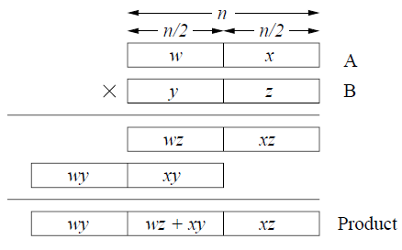
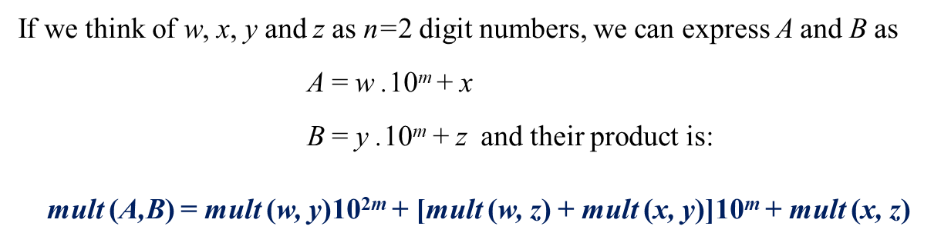
Long Integer Multiplication

Slide 13
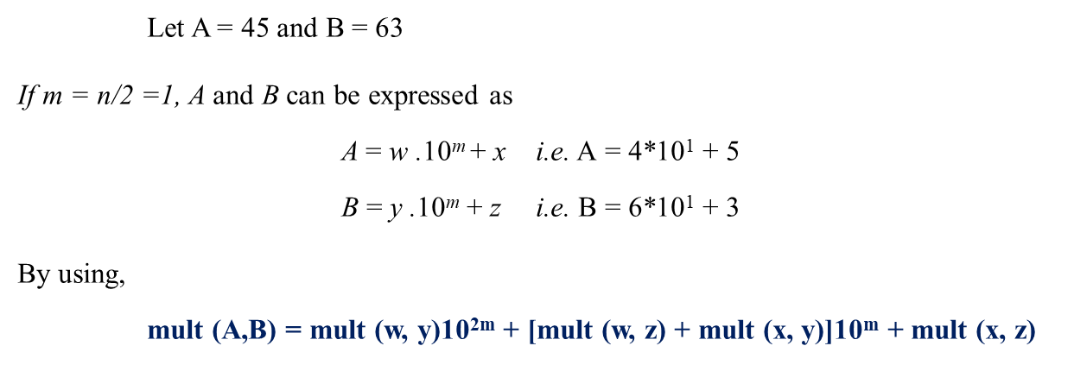
Long Integer Multiplication
The result of A*B can be obtained as:
= (4*6)*10²⁽¹⁾ + [4*3 + 5*6]*10¹ + 5*3
= 24 * 100 + [12 + 30] * 10 + 15
= 2400 + 420 +15
= 2835 Complexity = O(n)

Slide 14
Recursive Approach
a = a₁a₀ and b = b₁b₀
c = a * b
  = (a₁10^{n/2} + a₀) * (b₁10^{n/2} + b₀) // m may be replaced with n/2
  = (a₁ * b₁)10^{n} + (a₁ * b₀ + a₀ * b₁)10^{n/2} + (a₀ * b₀)
  For instance:
  a = 123456, b = 1178933:
  Then c = a * b = (123*10³+456)*(1178*10³+933)
  =(123 * 1178)10⁶ + (123 * 933 + 456 * 1178)10³ + (456 * 933)
  Then Recursively, these smaller integers can be multiplied by dividing them into yet smaller integers. This division process continues until a threshold value is reached at which time the multiplication can be done in the standard way.

Slide 15
Recursive Approach
Let a = a₁a₀ and b = b₁b₀
a, b : n-digit integers
a₁, a₀, b₁, b₀ : n/2-digit integers
c = a * b
  = (a₁ * b₁)10^{n} + (a₁ * b₀ + a₀ * b₁)10^{n/2} + (a₀ * b₀)
  = c₂10^{n} + c₁10^{n/2} + c₀,
  where
  c₂ = a₁ * b₁ is the product of their first halves
  c₀ = a₀ * b₀ is the product of their second halves
  c₁ = (a₁ + a₀) * (b₁ + b₀) – (c₂ + c₀) is the product of the sum of the a’s halves and the sum of the b’s halves minus the sum of c₂ and c₀.

Slide 16
Recursive Function
large_integer mult(large_integer a, large_integer b) // Pseudocode
{
large_integer w, x, y, z;
int m, n;
n = maximum(No. of digits(a), No. of digits(b))
if(a == 0 || b == 0)
return 0;
else if(n <= threshold) //e.g. threshold = 4 return a * b obtained in the usual way;
else
{ m = int(n/2); //m is mid
x = a / 10^{m}; y = a % 10^{m};
w = b / 10^{m}; z = b % 10^{m};
return mult(x,w)*10^{2m} + (mult(x, z) + mult(w, y))*10^{m} + mult(y, z);
}
}

Slide 17
#include <string.h>
int main()
{
int arr[500]={0};
int i,j,n;
char var1[500];
printf("Please enter a number:\n");
scanf("%s",var1);
strrev(var1);
n=strlen(var1);
for (i = 0,j=0; i < n; i++ )
{
if(var1[i]>='0' && var1[i]<='9')
{
arr [j] = var1[i] - '0';
j++;
}
}

Slide 18
printf("\nConverted into Large No :\n");
for (i = 0; i < j; i++ )
{
printf("%d",arr[i]);
}
printf("\n");
i=0;
while(i<=j)
{
arr[i]++;
if(arr[i]==10)
{
arr[i]=0;
i++;
}
else
{
break;
}
}
printf("\nAfter increasing by one unit No :\n");
for (i = j; i >=0; i-- )
{
if(!(i==j&&arr[i]==0))
printf("%d", arr[i]);
}
}

Slide 19
What is the number ‘ 1’? a) Prime number b) Composite number c) Neither Prime nor Composite d) None of the mentioned

Slide 20
Sum of two different prime number is a ____________
a) Prime number
b) Composite number
c) Either Prime or Composite
d) None of the mentioned

Slide 21
Explanation: Eg:- 2 + 3 = 5 a prime, 3 + 7 = 10 a composite.

Slide 22
The composite numbers has
more than two factors
infinite factors
one factor
two factors

Slide 23
The numbers that have only two factors and are different from each other are called
odd numbers
prime numbers
composite numbers
even numbers

